Slide 1
ICS 104 - Introduction to Programming in Python and C
Objects and Classes
Part 2

Slide 2
Public Interface of a Class
When you design a class, start by specifying the public interface of the new class
What tasks will this class perform?
What methods will you need?
What parameters will the methods need to receive?

Slide 3
Example Public Interface (A Cash Register Class)
We want to use objects that simulate cash registers.
A cashier who rings up a sale presses a key to start the sale, then rings up each item. A display shows the amount owed as well as the total number of items purchased.

Slide 4
Example Public Interface (A Cash Register Class)
Tasks
Add the price of an item:
addItem(self, price)
Get the total amount owed
getTotal(self)
Get the count of items purchased.
getCount(self)
Clear the cash register to start a new sale.
clear(self)

Slide 5
Writing the Public Interface
## A simulated cash register that tracks the item count and the
# total amount due.
class CashRegister:
## Adds an item to this cash register.
# @param price the price of this item
def addItem(self, price):
# Method body - The method declaration make up the public
# interface of the class
## Gets the price of all items in the current sale.
# @return the total price
def getTotal(self) :
# The data and method bodies make up the private implementation
# of the class

Slide 6
Using the Class
After defining the class, we can now construct an object:
register1 = CashRegister()
# Constructs a CashRegister object

Slide 7
Using Methods
Now that an object has been constructed, we are ready to invoke a method:
register1.addItem(1.95) # Invokes a method

Slide 8
Instance Variables of Objects
Each object of a class has a separate set of instance variables

Slide 9
Constructors
A constructor is a method that initializes instance variable[s] of an object.
It is automatically called when an object is created.
Python uses the special name __init__ to define the constructor.
# Calling a method that matches the name of the class
# Invokes the constructor
def __init__(self):
self._itemCount = 0
self._totalPrice = 0.0

Slide 10
Default and Named Arguments
Only one constructor can be defined per class:
But you can define a constructor with default argument values that simulate multiple definitions
class BankAccount:
def __init__(self, initialBlance = 0.0):
self._balance = initialBalance
If no value is passed to the constructor when a BankAccount object is created, the default value will be used
joesAccount = BankAccount() # Balance is set to 0
ahmedsAccount = BankAccount(1000)
# Balance is set to 1000

Slide 11
Constructors Syntax

Slide 12
Constructors: self
The first parameter variable of every constructor must be self .
When the constructor is invoked to construct a new object, the self parameter variable is set to the object that is being initialized.

Slide 13
Constructors: self
def addItem(self, price) :
self._itemCount = self._itemCount + 1
self._totalPrice = self._totalPrice + price
Self is referred to the object being initialized
register1 = CashRegister()
After the constructor is finished register1 is a reference to the newly created object

Slide 14
Constructors: self
register1 = CashRegister()
After the constructor is finished register1 is a reference to the newly created object
This reference register1 allows methods of the object to be invoked
print ("Your total $", register1.getTotal())

Slide 15
Syntax: Instance Methods
Use instance variables inside methods of the class
Similar to the constructor, all other instance methods must include the self parameter as the first parameter
You must specify the self implicit parameter when using instance variables inside the class

Slide 16
Syntax: Instance Methods

Slide 17
Invoking Instance Methods
As with the constructor, every method must include the special self parameter variable, and it must be listed first.
When a method is called, a reference to the object on which the method was invoked (register1) is automatically passed to the self parameter variable:
register1.addItem(2.95)
def addItem(self, price)

Slide 18
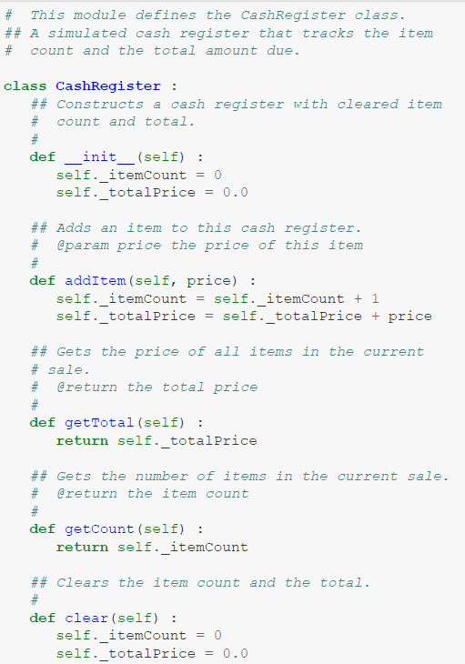
Complete Example

Slide 19
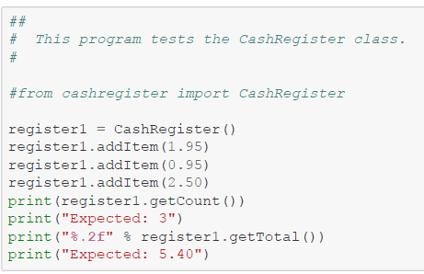
Complete Example

